Slide 1
PARALLEL COMPUTING

Slide 2

What is Serial Computing?
Traditionally, software has been written for serial computation: To be run on a single computer having a single Central Processing Unit (CPU);
A problem is broken into a discrete series of instructions.
Instructions are executed one after another.
Only one instruction may execute at any moment in time.

Slide 3
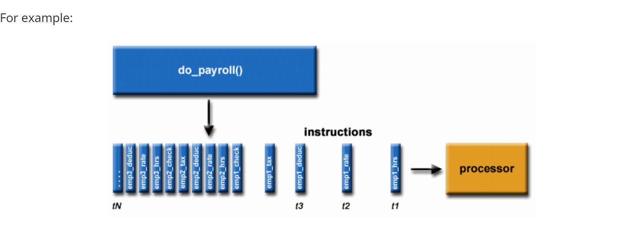

Slide 4
Limits to serial computing
Transmission speeds - the speed of a serial computer is directly dependent upon how fast data can move through hardware. Absolute limits are the speed of light (30 cm/nanosecond) and the transmission limit of copper wire (9 cm/nanosecond).
Limits to miniaturization - processor technology is allowing an increasing number of transistors to be placed on a chip. However, even with molecular or atomic-level components, a limit will be reached on how small components can be.
Economic limitations - it is increasingly expensive to make a single processor faster. Using a larger number of moderately fast commodity processors to achieve the same (or better) performance is less expensive.

Slide 5
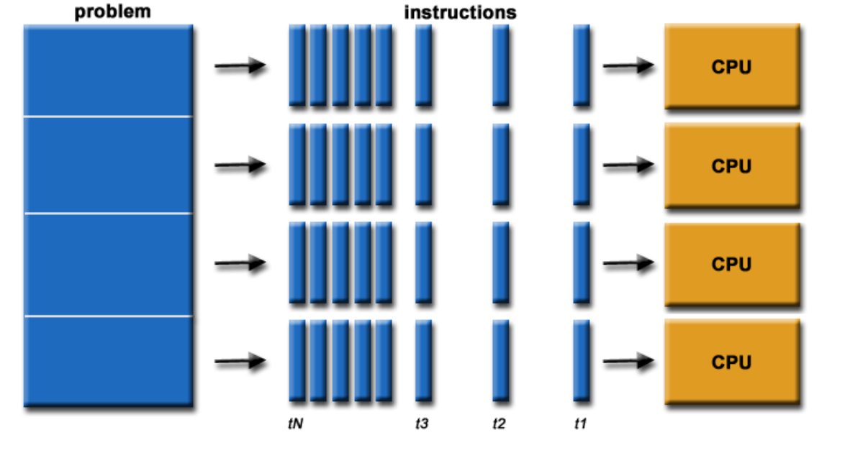
What is parallel computing?
In the simplest sense, parallel computing is the simultaneous use of multiple compute resources to solve a computational problem. To be run using multiple CPUs
A problem is broken into discrete parts that can be solved concurrently
Each part is further broken down to a series of instructions
Instructions from each part execute simultaneously on different CPUs

Slide 6
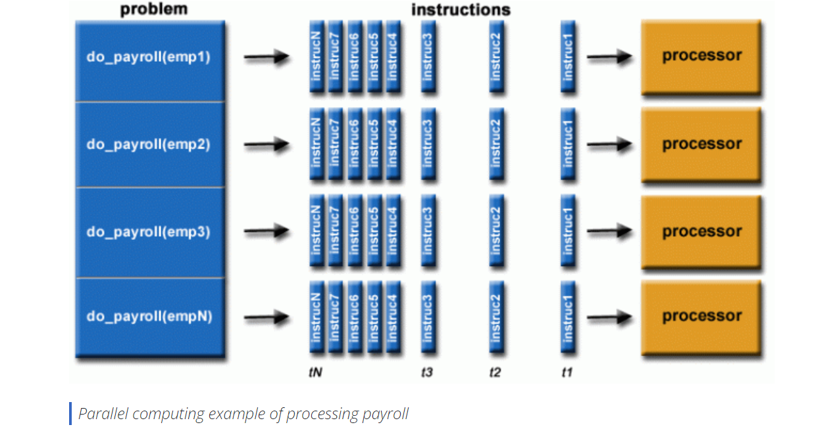

Slide 7
The compute resources can include
A single computer with multiple processors;
An arbitrary number of computers connected by a network;
A combination of both.
The computational problem usually demonstrates characteristics such as the ability to be:
Broken apart into discrete pieces of work that can be solved simultaneously;
Execute multiple program instructions at any moment in time;
Solved in less time with multiple compute resources than with a single compute resource.

Slide 8
PARALLEL COMPUTER
A parallel computer is a collection of processors, typically of the same type, interconnected in a certain fashion to allow the coordination of their activities and exchange of data.
Our main goal is to present algorithms that are suitable for implementation on parallel computers.
Virtually all stand-alone computers today are parallel from a hardware perspective:
Multiple functional units (L1 cache, L2 cache, branch, prefetch, decode, floating-point, graphics processing (GPU), integer, etc.)
Multiple execution units/cores
Multiple hardware threads

Slide 9
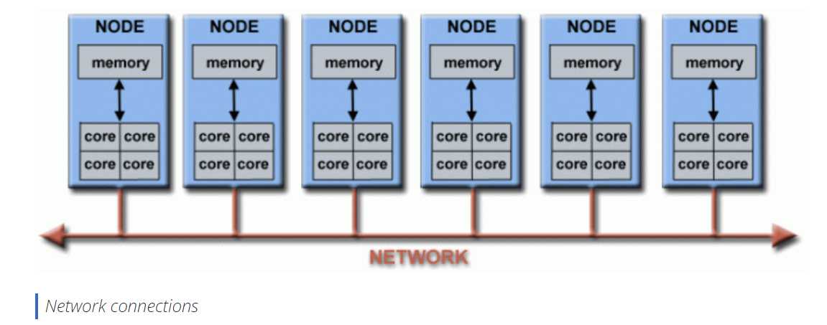
Networks connect multiple stand-alone computers (nodes) to make larger parallel computer clusters.

Slide 10
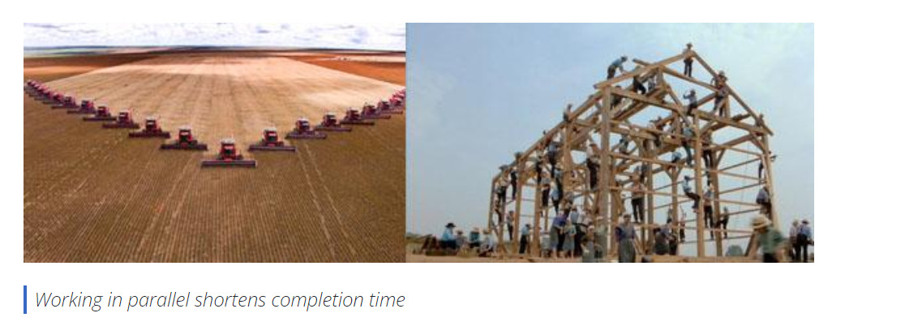
Why Use Parallel Computing?
SAVE TIME AND/OR MONEY
SOLVE LARGER / MORE COMPLEX PROBLEMS
Many problems are so large and/or complex that it is impractical or impossible to solve them using a serial program, especially given limited computer memory.
Example:
Grand Challenge Problems
Web search engines/databases processing millions of transactions every second

Slide 11

PROVIDE CONCURRENCY
A single compute resource can only do one thing at a time. Multiple compute resources can do many things simultaneously.
Example: Collaborative Networks provide a global venue where people from around the world can meet and conduct work "virtually."

Slide 12
TAKE ADVANTAGE OF NON-LOCAL RESOURCES
Using compute resources on a wide area network, or even the Internet when local compute resources are scarce or insufficient.
MAKE BETTER USE OF UNDERLYING PARALLEL HARDWARE
Modern computers, even laptops, are parallel in architecture with multiple processors/cores.
Parallel software is specifically intended for parallel hardware with multiple cores, threads, etc.
In most cases, serial programs run on modern computers "waste" potential computing power.

Slide 13
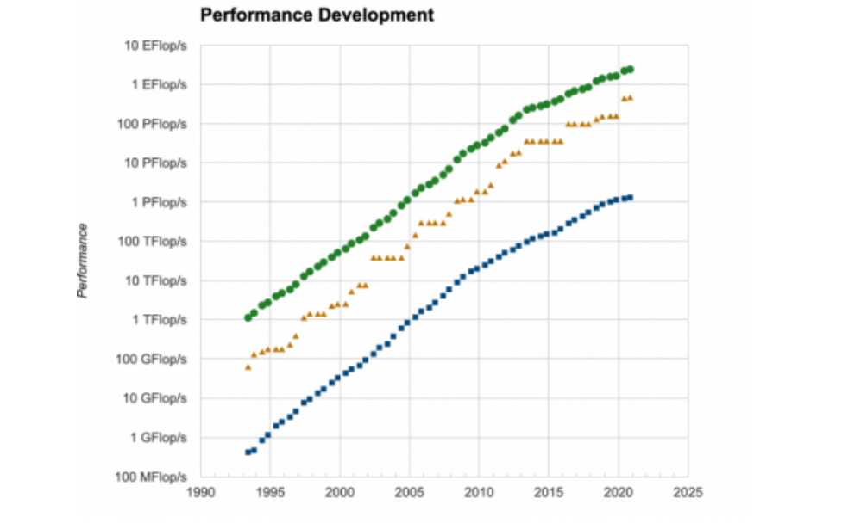
The Future
During the past 20+ years, the trends indicated by ever faster networks, distributed systems, and multi-processor computer architectures (even at the desktop level) clearly show that parallelism is the future of computing.
In this same time period, there has been a greater than 500,000x increase in supercomputer performance, with no end currently in sight.
The race is already on for Exascale Computing - we are entering Exascale era
Exaflop = 10¹⁸ calculations per second

Slide 14
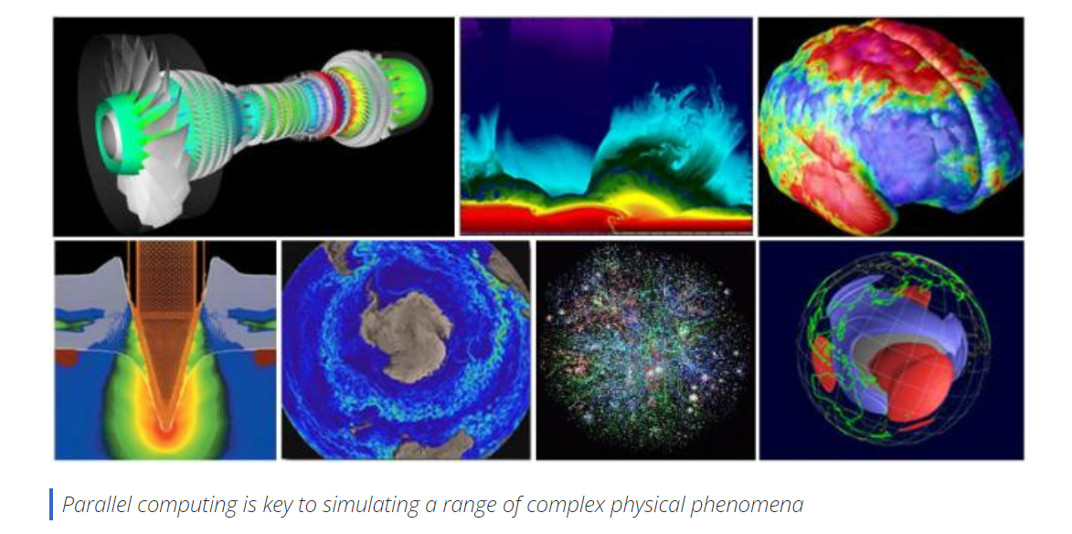
Who Is Using Parallel Computing? Science and Engineering

Slide 15
Historically, parallel computing has been considered to be "the high end of computing," and has been used to model difficult problems in many areas of science and engineering:
Atmosphere, Earth, Environment
Physics - applied, nuclear, particle, condensed matter, high pressure, fusion, photonics
Bioscience, Biotechnology, Genetics
Chemistry, Molecular Sciences
Geology, Seismology
Mechanical Engineering - from prosthetics to spacecraft
Electrical Engineering, Circuit Design, Microelectronics
Computer Science, Mathematics
Defense, Weapons

Slide 16
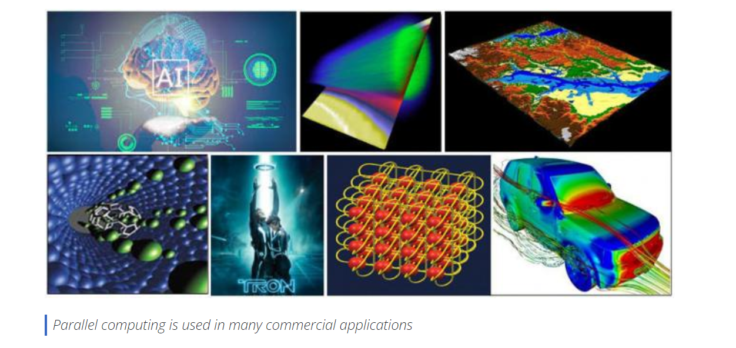
Industrial and Commercial

Slide 17
Today, commercial applications provide an equal or greater driving force in the development of faster computers. These applications require the processing of large amounts of data in sophisticated ways.
For example:
"Big Data," databases, data mining
Artificial Intelligence (AI)
Oil exploration
Web search engines, web based business services
Medical imaging and diagnosis
Pharmaceutical design
Financial and economic modeling
Management of national and multi-national corporations
Advanced graphics and virtual reality, particularly in the entertainment industry
Networked video and multi-media technologies
Collaborative work environments

Slide 18
Von Neumann Architecture
John Von-Neumann proposed his computer architecture design in 1945 which was later known as Von-Neumann Architecture
It is also known as IAS computer. –Institution for Advanced Studies.
A von Neumann computer uses the stored-program concept. The CPU executes a stored program that specifies a sequence of read and write operations on the memory.
This design is still used in most computers produced today.
Uses a single processor.
Uses one memory for both instructions and data.
Executes programs following the fetch-decode-execute cycle.

Slide 19
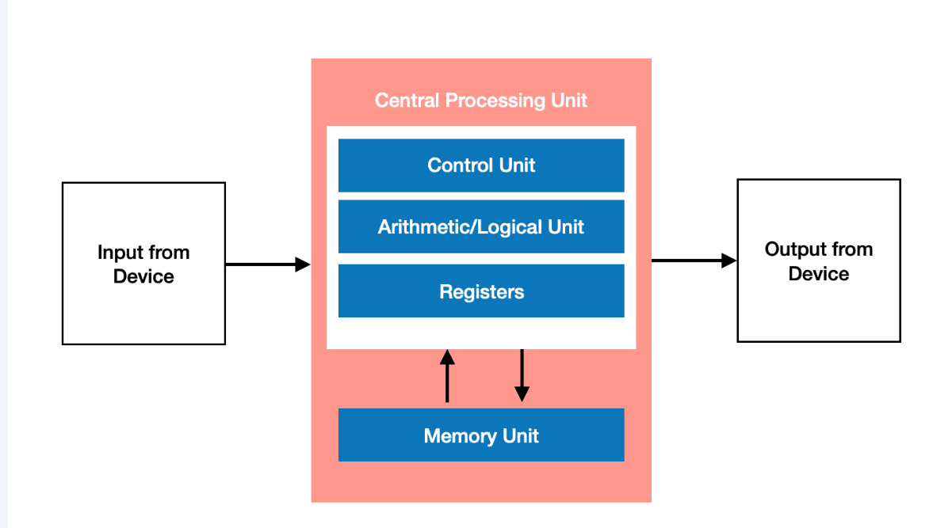
Basic design:
Memory is used to store both program and data instructions
Program instructions are coded data which tell the computer to do something
Data is simply information to be used by the program
A central processing unit (CPU) gets instructions and/or data from memory, decodes the instructions and then sequentially performs them.

Slide 20
Key Components of Von Neumann Architecture
Central Processing Unit (CPU): The part of a computer that carries out instructions and performs arithmetic, logical, and control operations.
Memory: A place where the computer stores and retrieves data and instructions.
Memory is divided into two types: primary memory, such as Random Access Memory (RAM), and secondary memory, like hard disk drives and solid-state drives.
Input-Output (I/O) devices: Components responsible for interfacing the computer with the external world. Examples of I/O devices include keyboards, mice, printers, and monitors.
System Bus: A communication pathway that connects the CPU, memory, and I/O devices, enabling data and control signals to flow between these components.

Slide 21
Flynn's Classical Taxonomy
There are different ways to classify parallel computers. One of the more widely used classifications, in use since 1966, is called Flynn's Taxonomy.
Flynn's taxonomy distinguishes multi-processor computer architectures according to how they can be classified along the two independent dimensions of Instruction and Data. Each of these dimensions can have only one of two possible states: Single or Multiple.
Parallel computers can be classified in at least four ways:
Single Instruction stream Single Data stream (SISD)
Single Instruction stream Multiple Data stream (SIMD)
Multiple Instruction stream Single Data stream (MISD)
Multiple Instruction stream Multiple Data stream (MIMD)

Slide 22
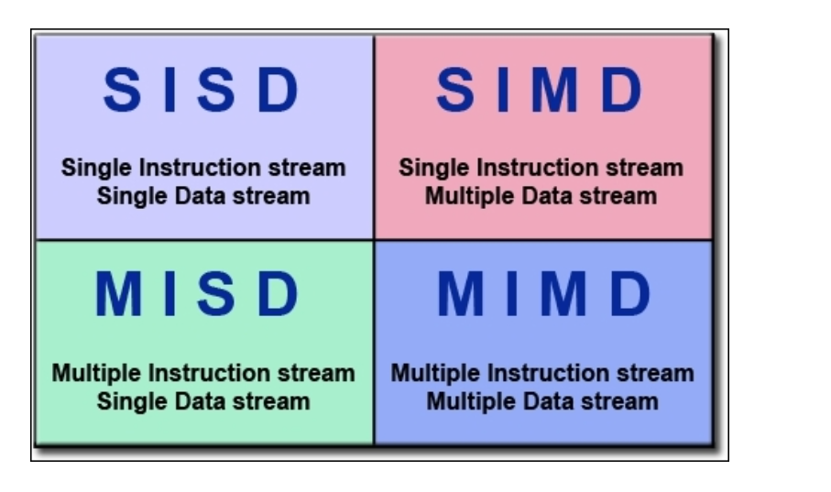

Slide 23
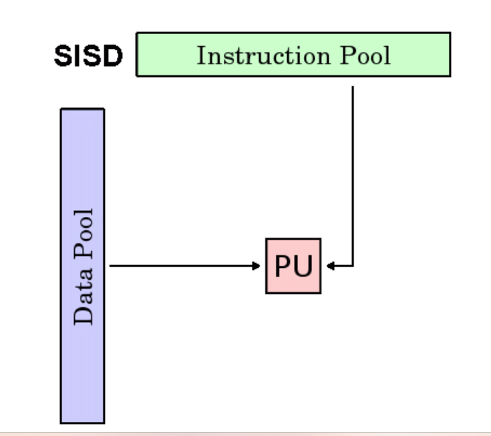
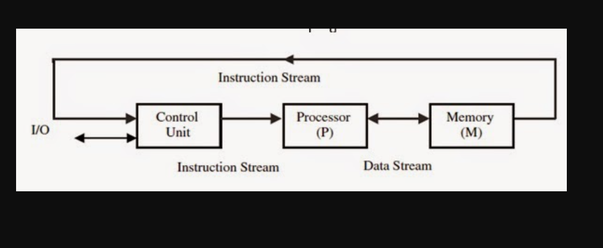
Single Instruction, Single Data (SISD):

Slide 24
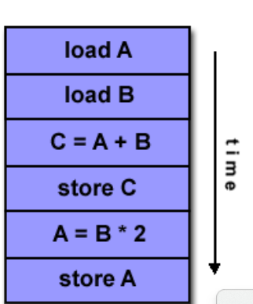
Single Instruction, Single Data (SISD):
A serial (non-parallel) computer
Single instruction: only one instruction stream is being acted on by the CPU during any one clock cycle
Single data: only one data stream is being used as input during any one clock cycle
Deterministic execution
This is the oldest and until recently, the most prevalent form of computer
Examples: most PCs, single CPU workstations and mainframes

Slide 25
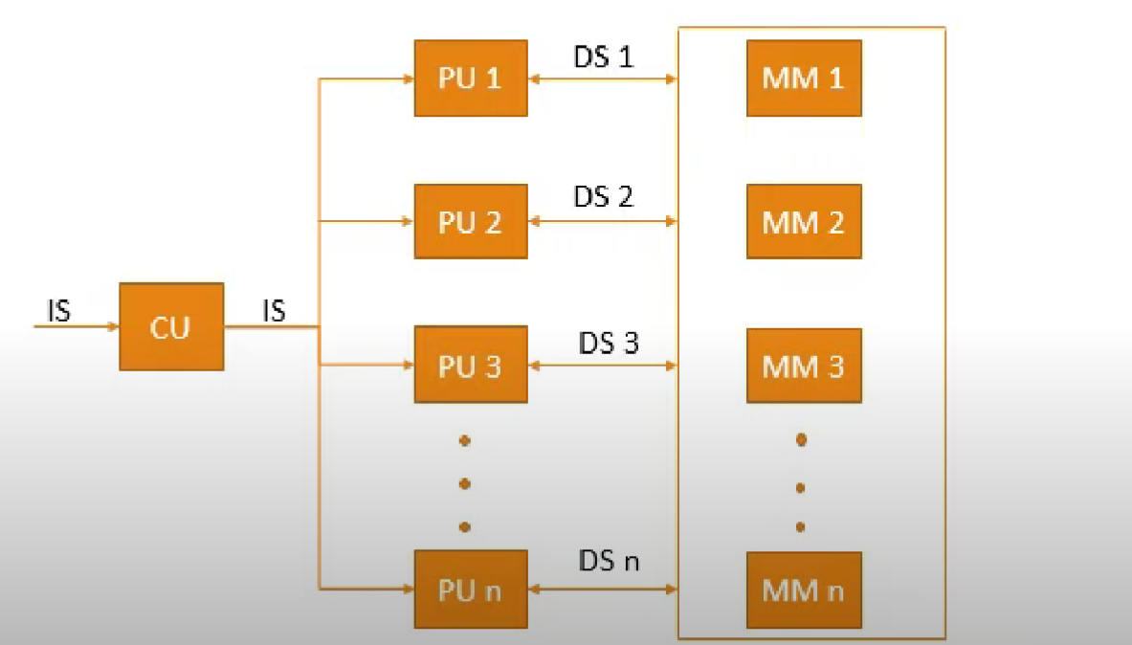
Single Instruction, Multiple Data (SIMD)

Slide 26
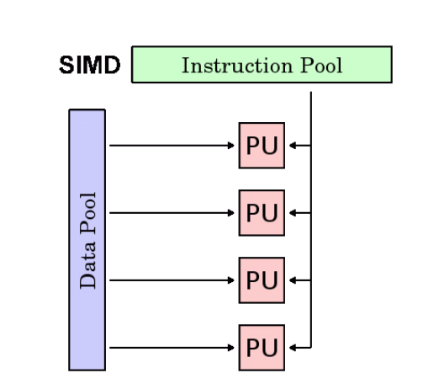
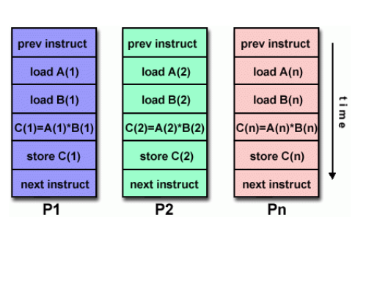
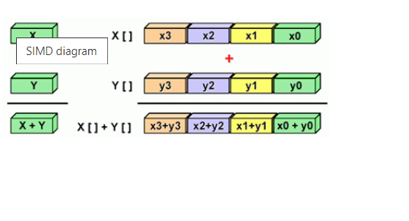

Slide 27
Single Instruction, Multiple Data (SIMD):
A type of parallel computer
Single instruction: All processing units execute the same instruction at any given clock cycle
Multiple data: Each processing unit can operate on a different data element.
Best suited for specialized problems characterized by a high degree of regularity, such as image processing.
Synchronous and deterministic execution
Two varieties: Processor Arrays and Vector Pipelines
Examples:
Processor Arrays: Connection Machine CM-2, Maspar MP-1, MP-2
Vector Pipelines: IBM 9000, Cray C90, Fujitsu VP, NEC SX-2, Hitachi S820

Slide 28
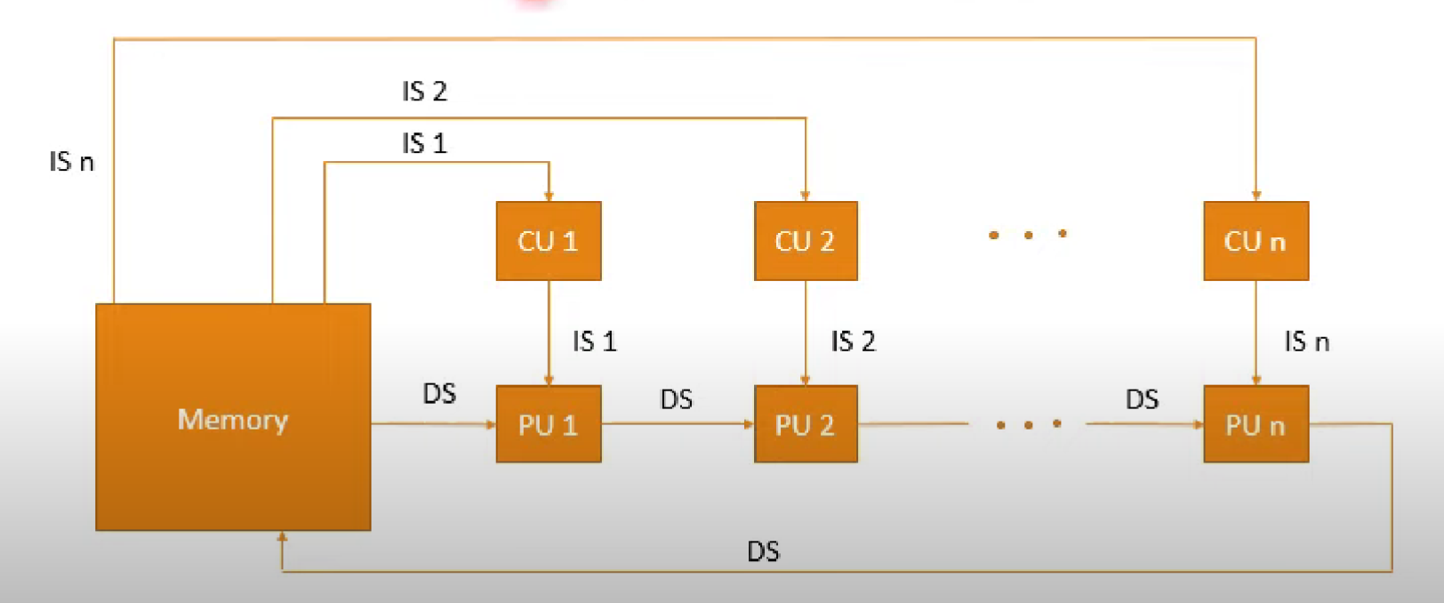
Multiple Instruction, Single Data (MISD):

Slide 29
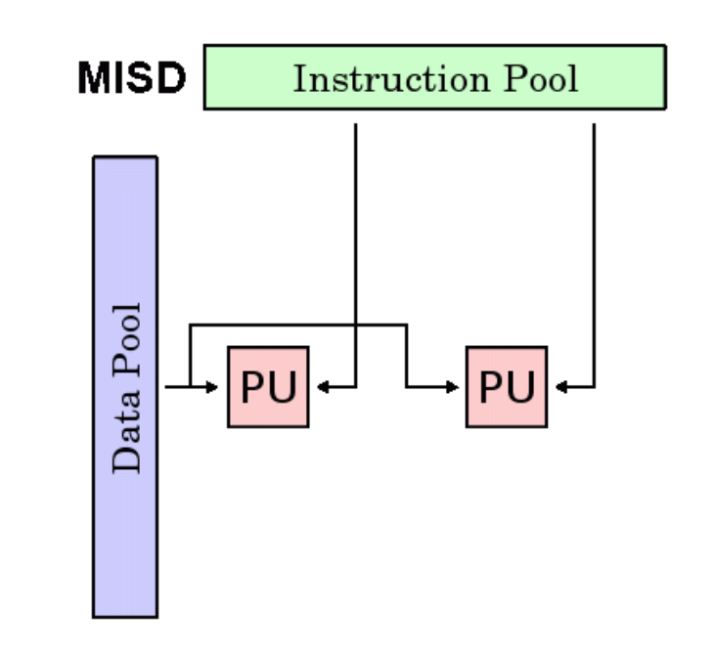
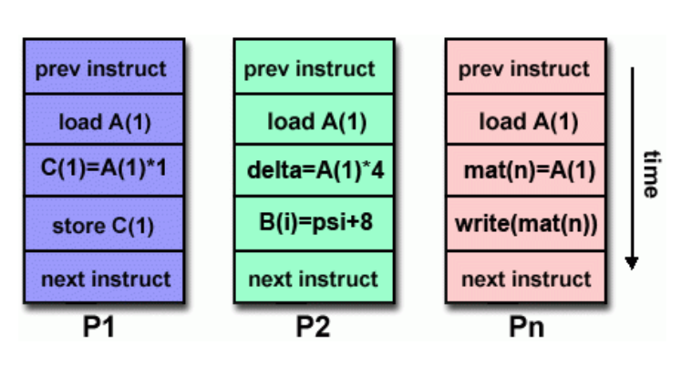

Slide 30
Multiple Instruction, Single Data (MISD):
A single data stream is fed into multiple processing units.
Each processing unit operates on the data independently via independent instruction streams.
Few actual examples of this class of parallel computer have ever existed. One is the experimental Carnegie-Mellon computer (1971).
Some conceivable uses might be:
multiple frequency filters operating on a single signal stream
multiple cryptography algorithms attempting to crack a single coded message.

Slide 31
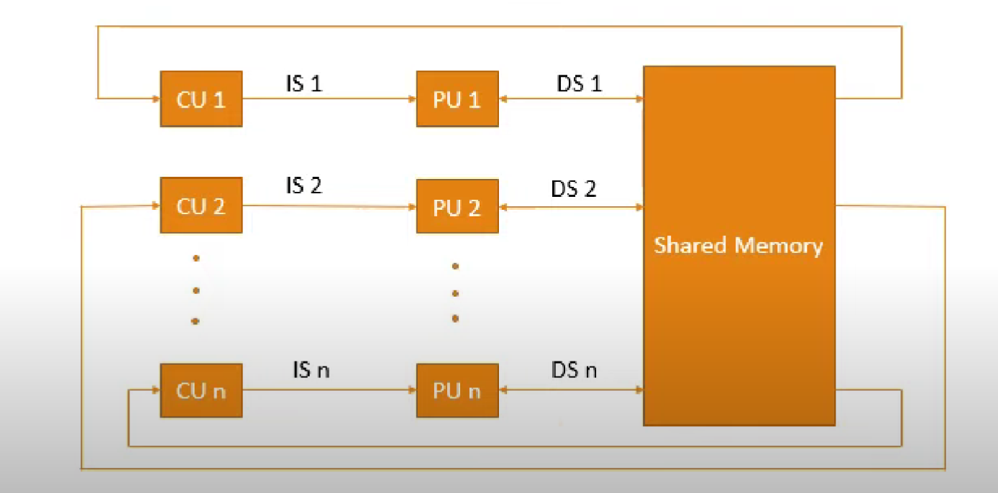
Multiple Instruction, Multiple Data (MIMD

Slide 32
Multiple Instruction, Multiple Data (MIMD):
Currently, the most common type of parallel computer. Most modern computers fall into this category.
Multiple Instruction: every processor may be executing a different instruction stream
Multiple Data: every processor may be working with a different data stream
Execution can be synchronous or asynchronous, deterministic or non-deterministic
Examples: most current supercomputers, networked parallel computer "grids" and multi-processor SMP computers - including some types of PCs.

Slide 33
